Slide 1

Evaluating the use of Micro-Electro-Mechanical-Systems sensor in detecting and monitoring motor developmental delays in children with Autism Spectrum Disorder An Exploratory Study
Fakoya, Mildred
DGMD S-14 WEARABLE DEVICES AND COMPUTER VISION, Summer 2020
Harvard University, Extension

Slide 2
Introduction
The measurement and analysis of motor skills involves measurement of a set of movement profiles. In this project, 2 activities categorized as Gross-motor movement and 2 activities as Fine-motor movement were conducted. We used hand movement to measure fine motor. A sensortile was placed on the wrist and toe of the subject for measurements of Fine and Gross motor movement respectively. The sensortile used are lightweight and does not affect the natural movement of the hands and legs.
https://youtu.be/O--TZ43lbMY

Slide 3
Background
The frequent association of ASD with other neurological and extra-neurological signs suggests that autism could be considered as a multiorgan systemic disorder with a primary central nervous system involvement.
Evidence of neuromuscular disorder (dystrophinopathies and congenital muscular dystrophy due to mutations of POMGnT1 gene) has been documented in a subset of patients affected by syndromic ASD, however, only few case reports and small samples studies with specific features have been reported in literature. https://www.ncbi.nlm.nih.gov/pmc/articles/PMC3235842/

Slide 4
Methods: I collected motion profile of an autism subject and a control subject to evaluate the use of motion sensor for early detection of motor disorder/delays and monitoring of progress during therapy.
A sensortile was placed on the foot and wrist of the subjects. The sensortile holds and accelerometer that was used to collect the acceleration and the gyroscope for the angular rate of the subject over a period of 60 seconds at a time.

Slide 5
Tools Used / Definitions
Acceleration:
It is the rate of change of the velocity of an object
Angular rate:
It is the change in angular velocity about an axis. It is used to check the stability of the subject The unit of measurement if deg/sec
Accelerometer:
Measures the linear acceleration along X, Y, Z axes. It measures the acceleration of a body in its instantaneous rest frame. The unit of measurement is m/s2 or g (G-forces). The STEVAL-STLKT01V1 development kit was used for prototyping and evaluation. The sensortile holds a MEMS accelerometer that was used to collect the linear acceleration of the subject during an activity.
Gyroscope:
MEMS gyroscope was used to measure angular velocity. The units of angular velocity are measured in degrees per second (°/s) or revolutions per second (RPS). The angular rate is used to evaluate the balance of the subject since it senses rotation.

Slide 6
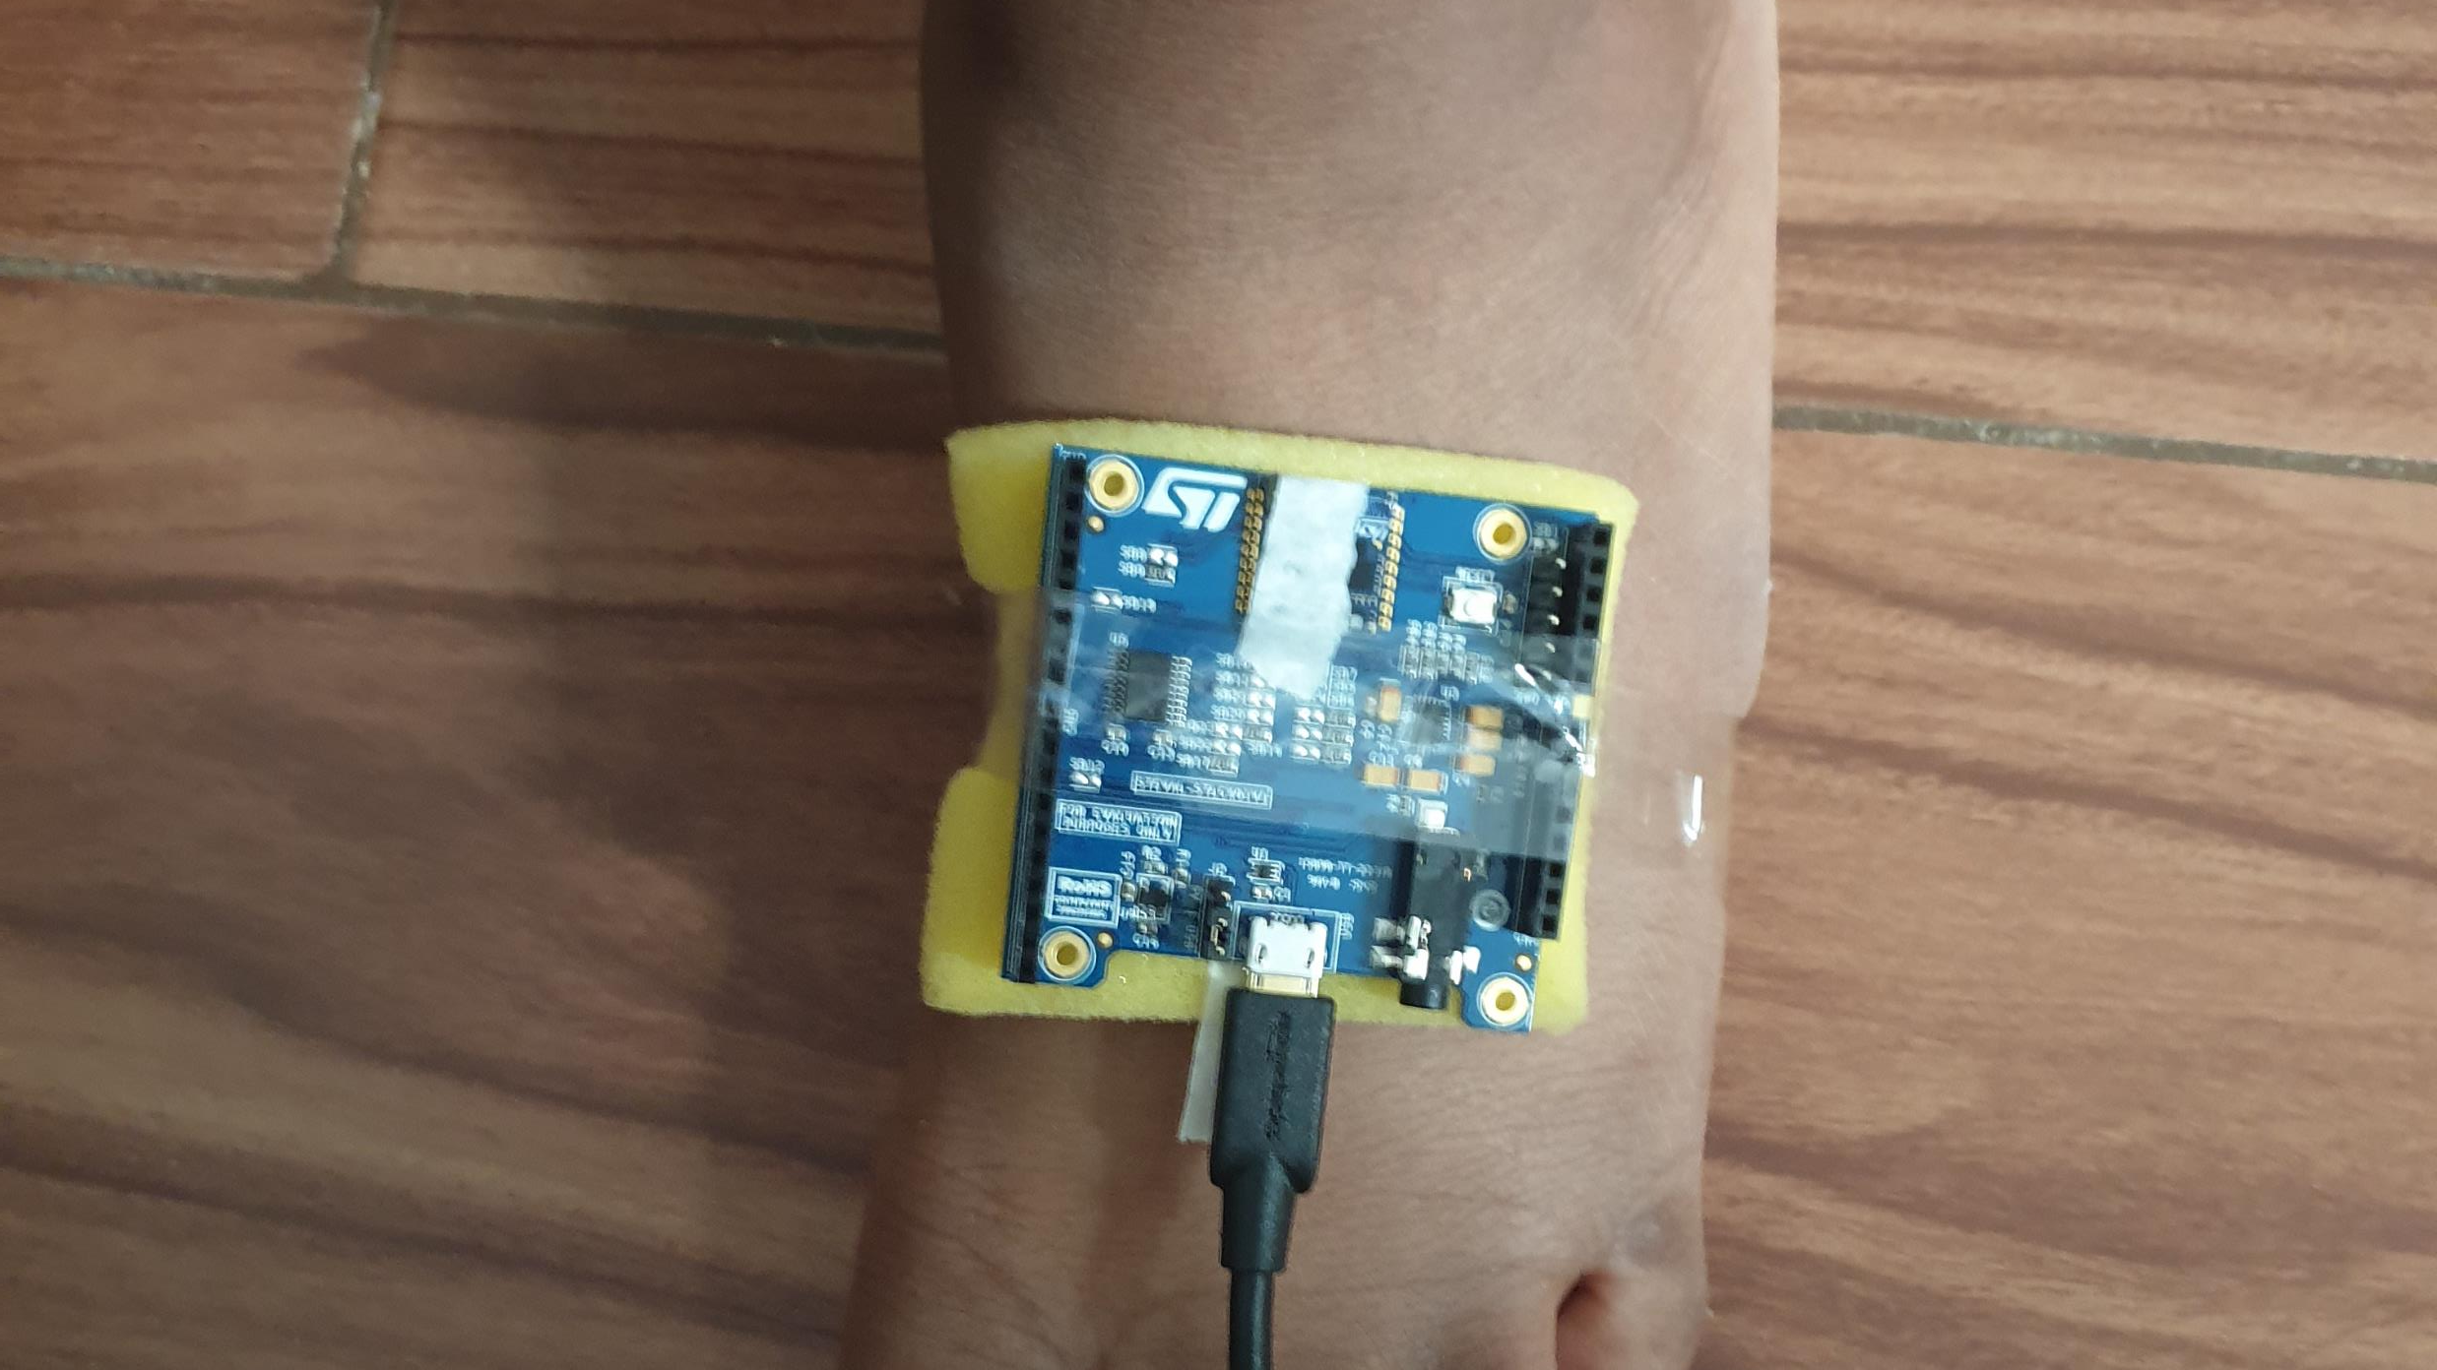
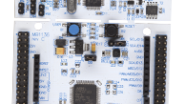
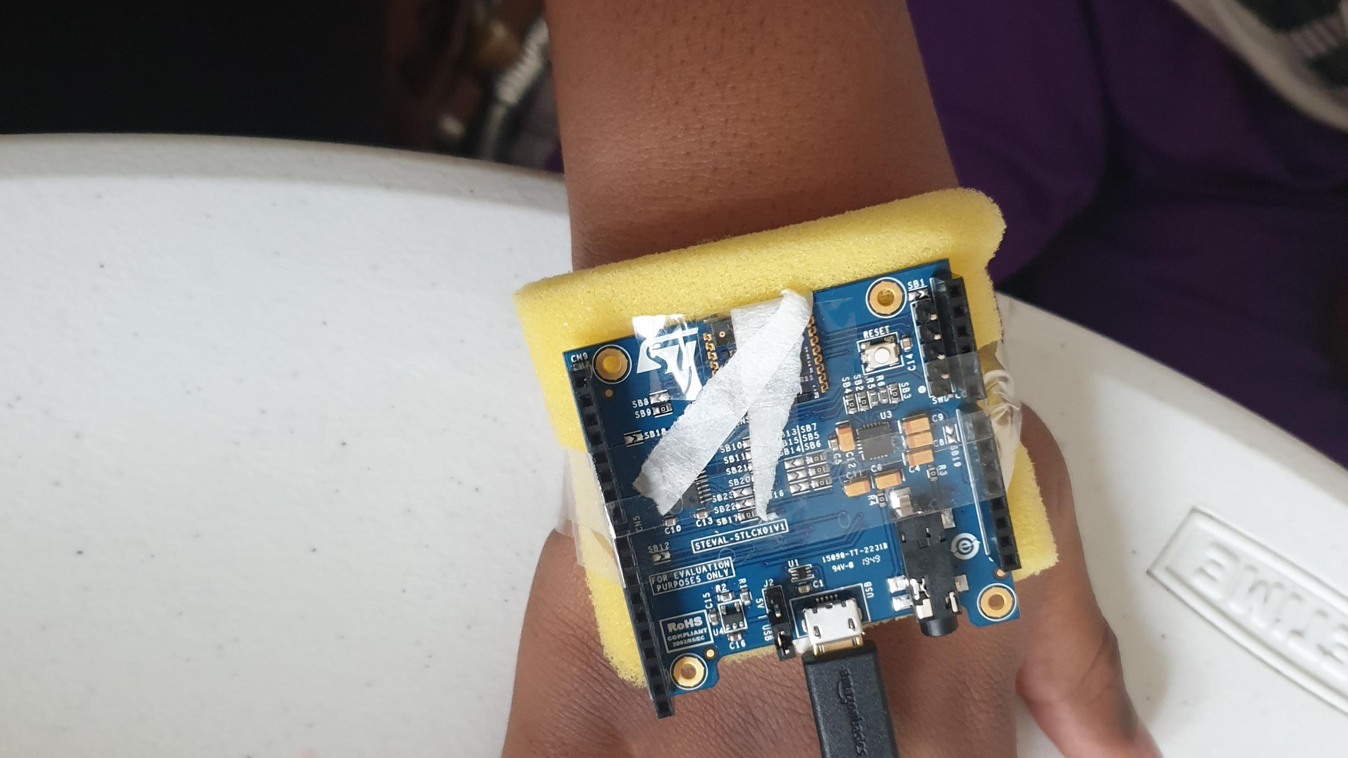
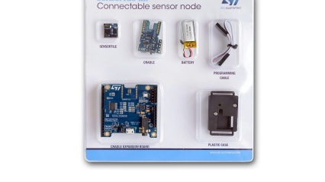
Data collection tools Accelerometer – acceleration Gyroscope – angular rate

Slide 7
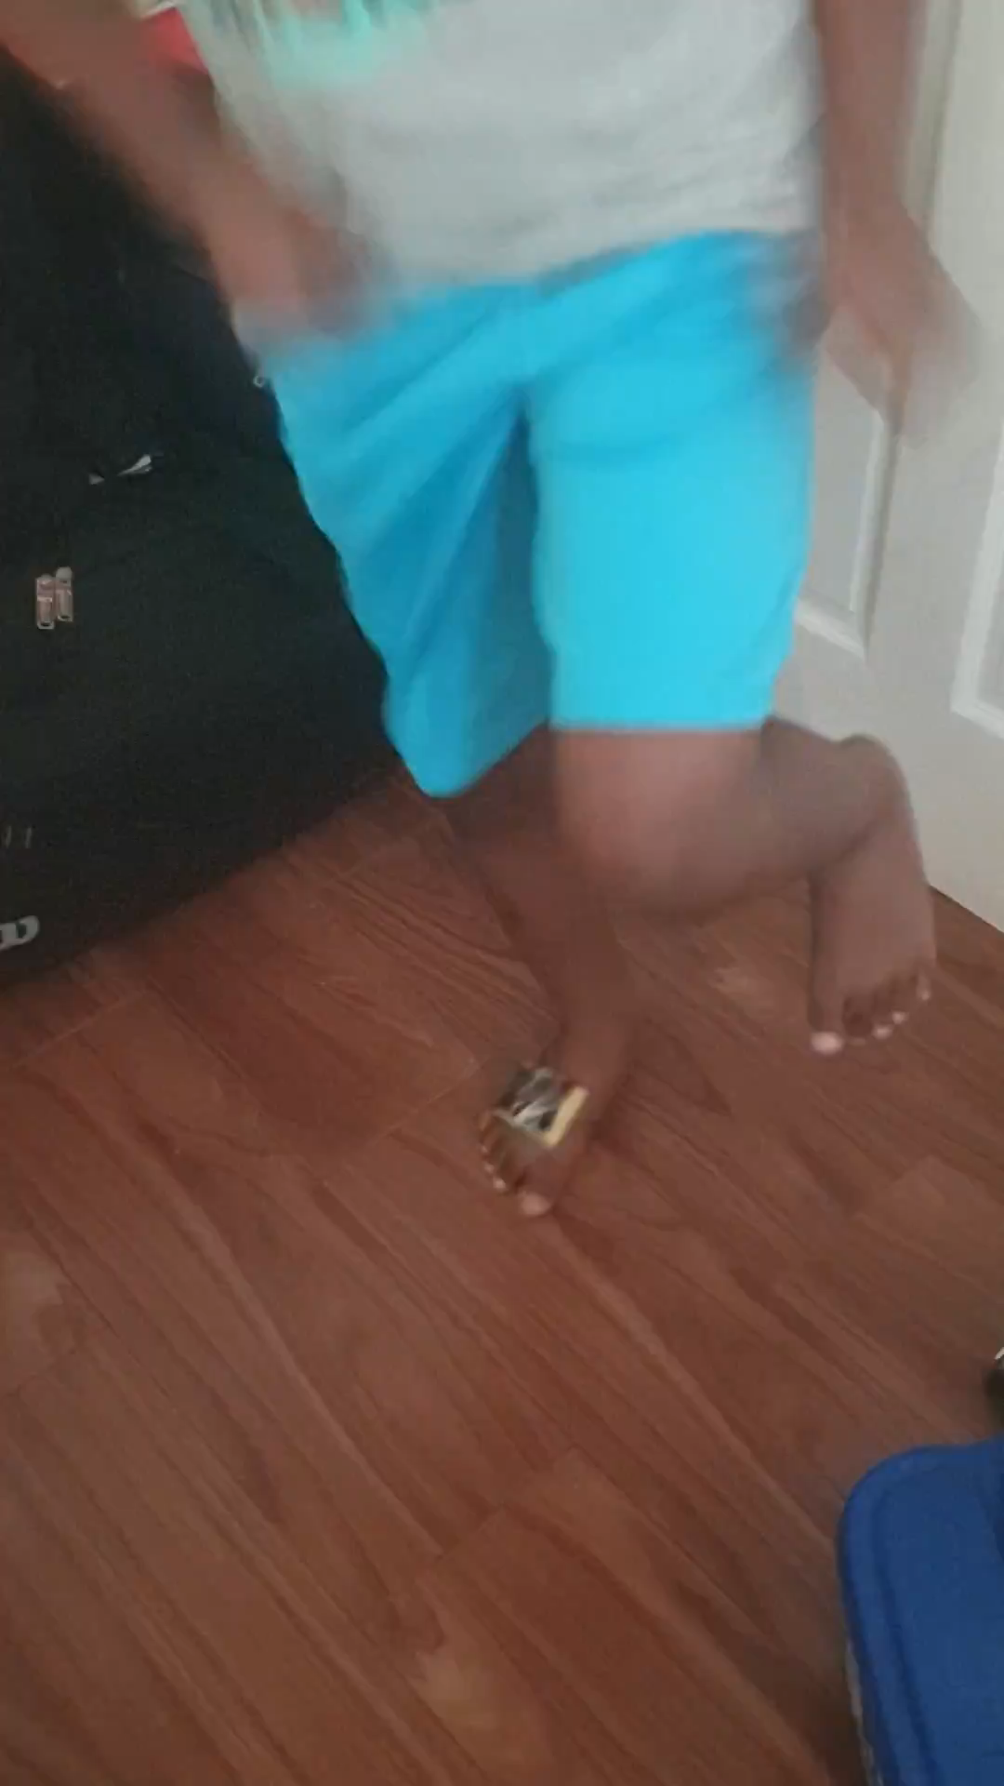
Activities
Jumping on one leg
Jumping of both legs
Stacking small blocks
Coloring tiny dots
Timing
60 secs at a time per activity over several days

Slide 8
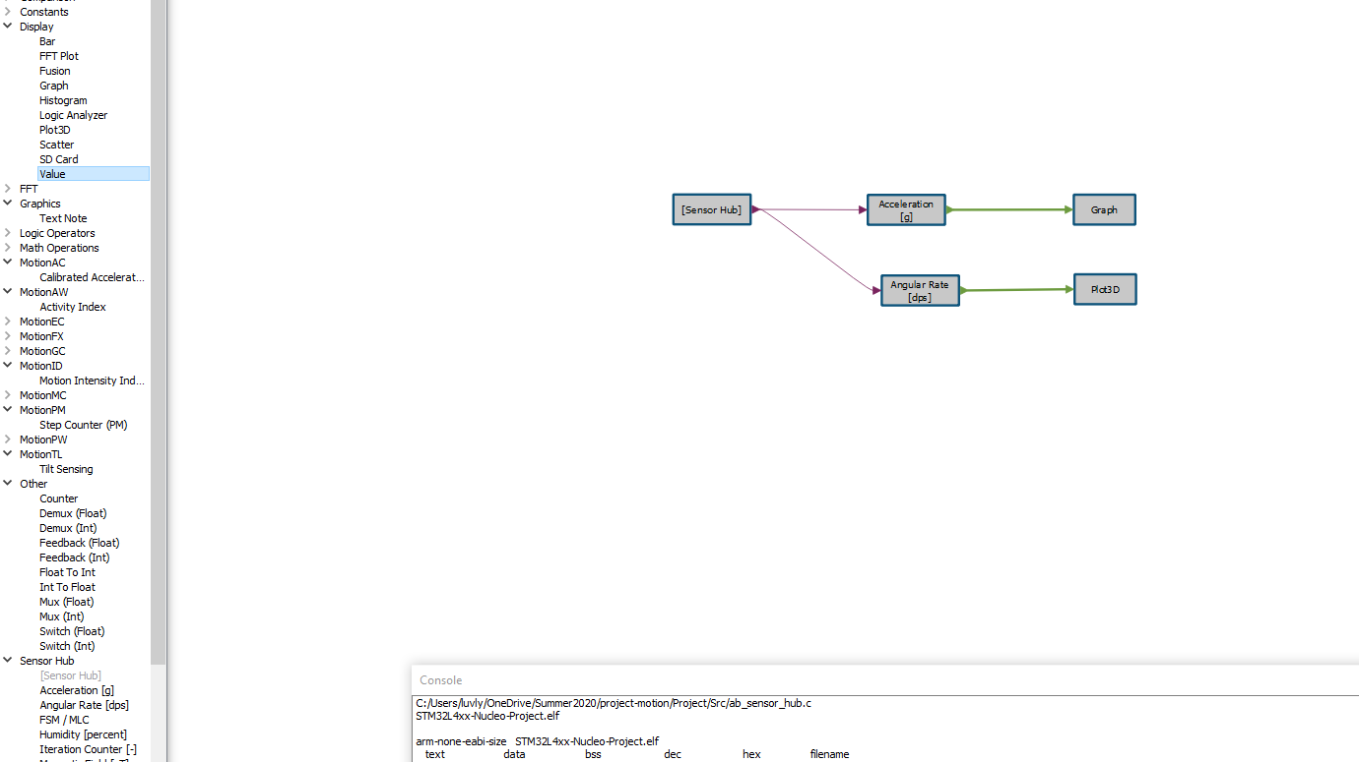
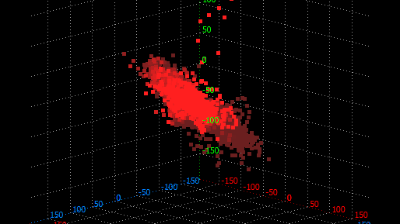
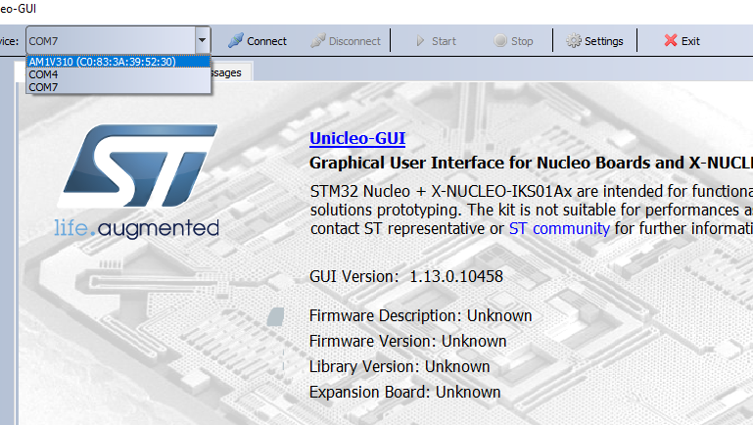
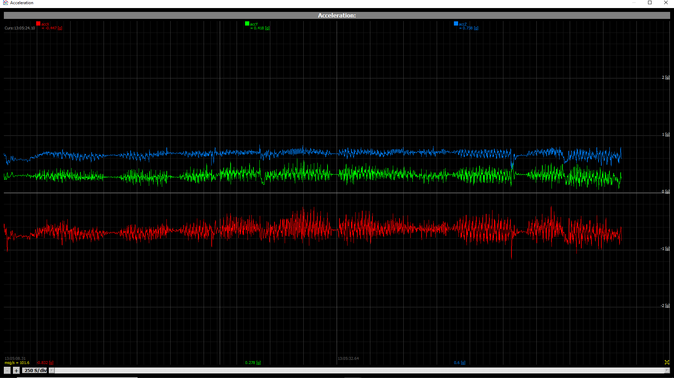
Environmental setup - Algo builder to create the prototype for the project - Unicleo GUI for data reading and export

Slide 9
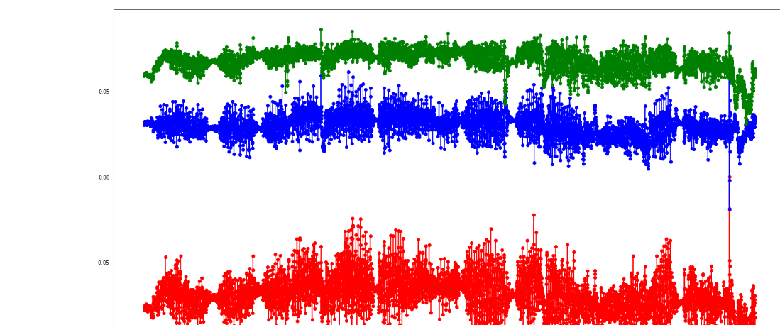
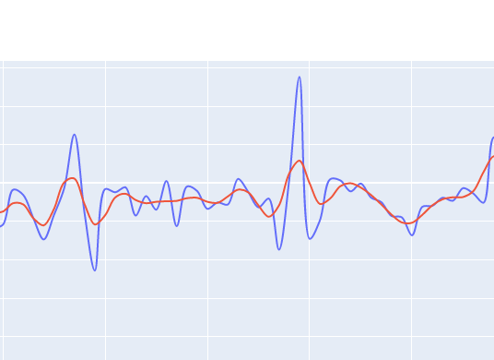
Exploratory analysis
- Removed acceleration due to gravity from each data point.
Resampled by down sampling to 1sec data points
Applied low pass filter to eliminate noise and irregularities.

Slide 10
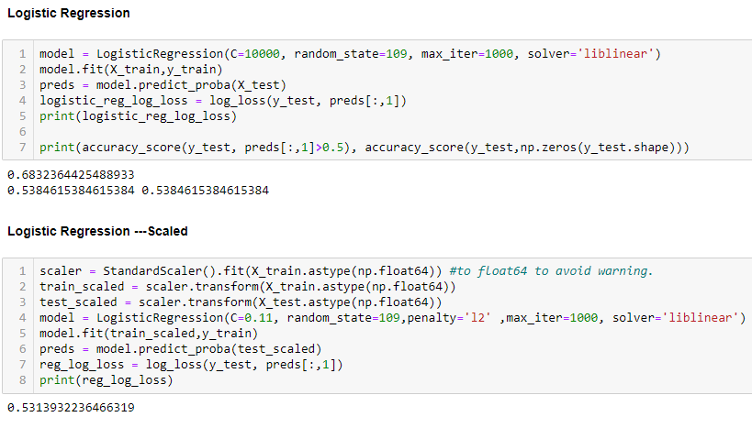
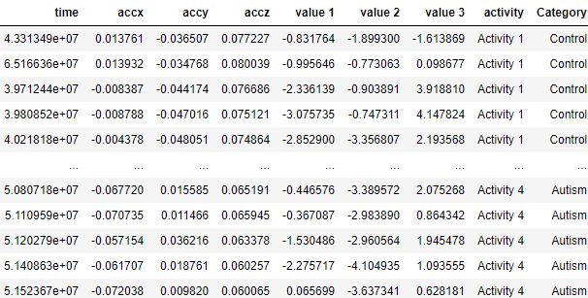
Logistic Regression

Slide 11
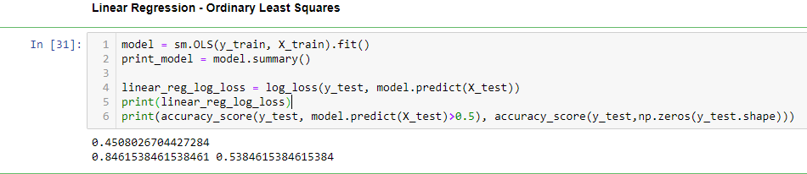
Linear Regression

Slide 12
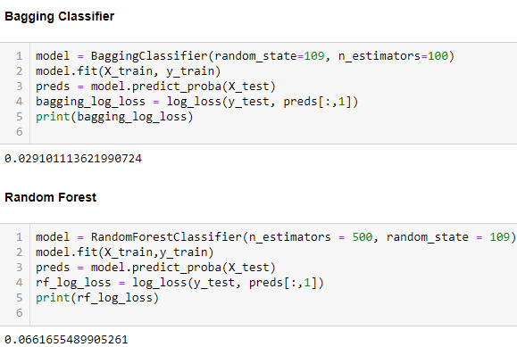
Bagging classifier & Random Forest

Slide 13
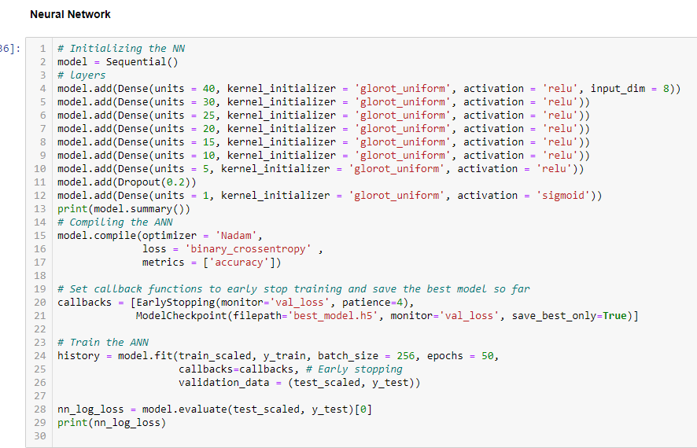
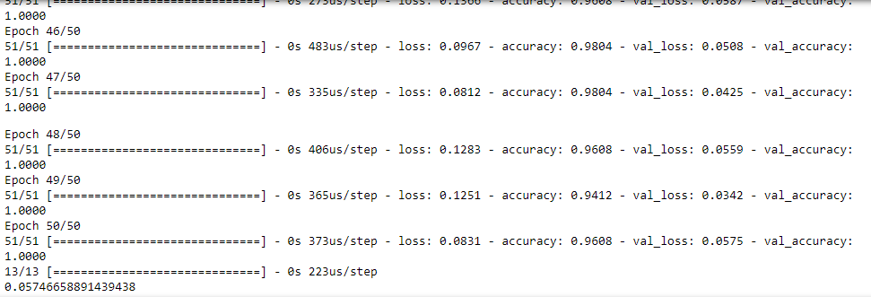

Slide 14
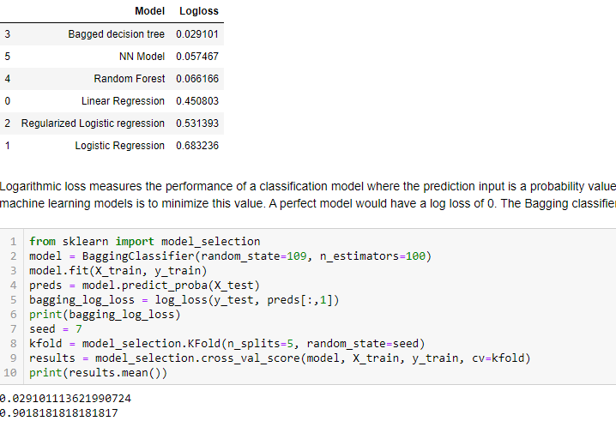
Comparing models

Slide 15
Conclusion
Given the successful performance of the Bagging classifier and the neural network in this experiment more sample size and subjects will be needed to come to a definite conclusion on the use of motion sensors in convenient ways that will lead to discoveries that are difficult to evaluate by humans. Other classifiers as it relates to the types of activities and the category of motor with delays can also be created further from the collected data.

